Slide 1
object oriented programming
Facilitator:INDRANI SEN

Slide 2
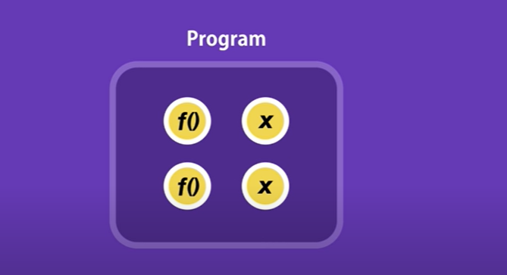
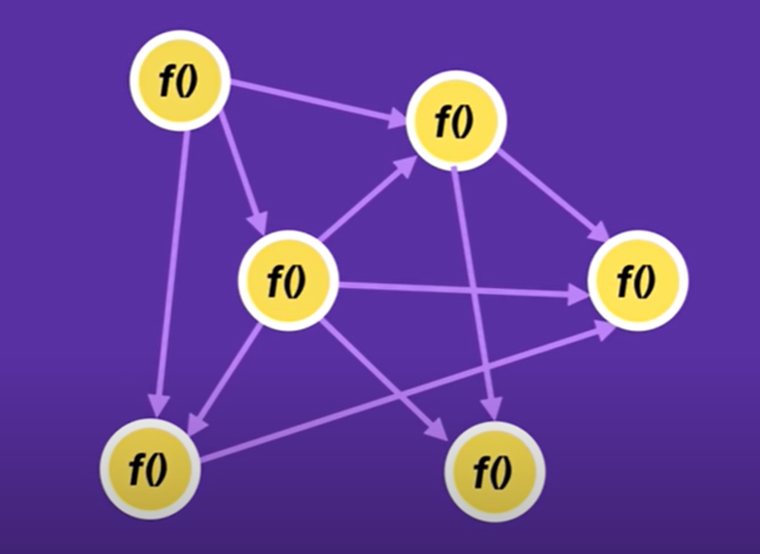
Procedural programming
Prior to object oriented programming approach the procedural approach used to program problems.
In procedural programming languages long list of instruction used which make this very difficult to manage.

Slide 3
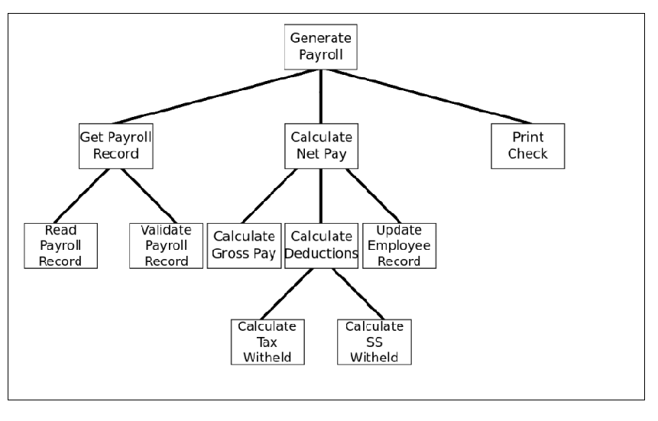
A modularized program

Slide 4
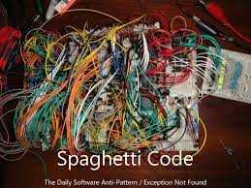
Spagetti code

Slide 5

What is an object?
An object is a unique programming entity that has attributes to describe it and methods to retrieve/set attribute values.

Slide 6
Object Characteristics
State: The state or attributes are the built in characteristics or properties of an object. For example, a T.V has the size, color, model etc.
Behavior of the object - The behavior or operations of an object are its predefined functions.
For example, a T.V. can show picture , change channels, tune for a channel etc.
in object oriented programming terminology the behavior is implemented through methods.
Object identity - Each object is uniquely identifiable through its name and ID e.g Every TV can be identified with its serial_no, model_no etc.

Slide 7
State or Attributes
Programmers store an object’s data in attributes, also called properties.
Attributes can be subjected to two types of operations:-
Read
Write
We can read property values or change properties, assigning values.

Slide 8
Model
Car Number
No. Of Wheels
Engine No
Color
Chassis No
State_registered
Owner _name
Fuel _Tank_capacity
Fuel_level
Mileage

Slide 9
Behavors or Methods
Whereas attributes describe an object, methods allow us to access object data.
Methods are like verbs in grammar.
We can manipulate object data, stored in attributes, using methods.
Consume_petrol()
Input_data()
Display_data()
Cover_journey()

Slide 10
Class Operations or methods
PhoneBook
newEntry (n : Name, a : Address, p : PhoneNumber, d : Description)
getPhone ( n : Name, a : Address) : PhoneNumber
You can specify an operation by stating its signature: listing the name, type, and default value of all parameters, and, in the case of functions, a return type.

Slide 11
Abstraction
One of the chief advantages of object-oriented programming is the idea that programmers can essentially focus on the “big picture” and ignore specific details regarding the inner-workings of an object. This concept is called abstraction.
Fuel_Level
Car_no
Fuel_tank_capacity
Mileage
Input_data()
Display_data()

Slide 12
Object representation
An object is represented as shown below:
Data members - Data members are the variables.
They establish the state or attributes for the object.
Member functions - Member functions represent the code to manipulate the data. The behavior of the object is determined by the member functions.

Slide 13
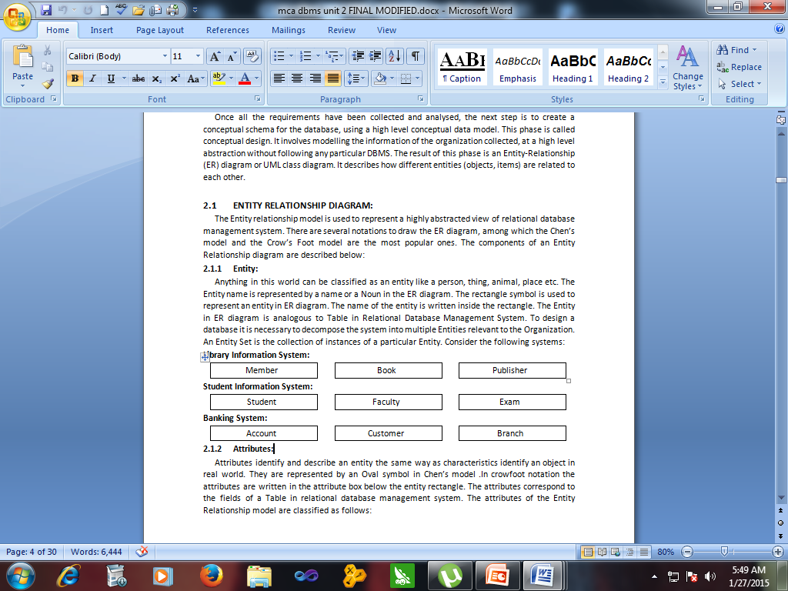
Some useful classes

Slide 14
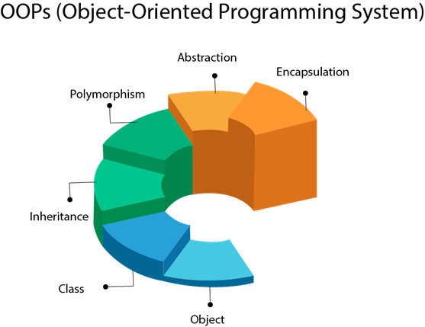
Features of OOP
(https://francescolelli.info, n.d)

Slide 15
Encapsulation
Abstraction in OOP is closely related to a concept called encapsulation.
Data and the ways to get at that data are wrapped in a single package, a class.
The only way to access such data is through that package.
This idea translates to information hiding.
The data members are private to the class.
They can be accessed by only the member methods, which are public and are callable anywhere in the program through the object reference.

Slide 16
Class Attributes (Cont’d)
Person
Attributes can be:
+ public
# protected
- private
+ name : String
# address : Address
# birthdate : Date
/ age : Date
- ssn : Id

Slide 17
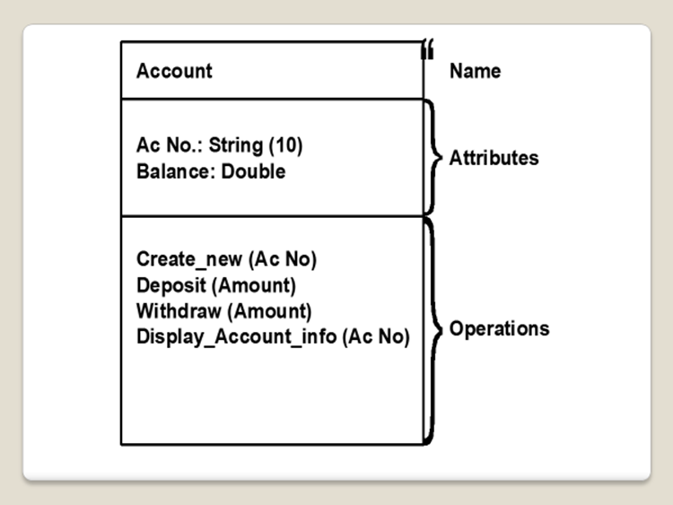
Classes
How do programmers implement abstraction?
They use a programming structure called a class.
A class presents a blueprint of an object, its properties and its methods.

Slide 18
Examples of classes
Student
Account
Roll: long
Name: String
Height :FLoat
Weight :Float
Tot_Marks: Float
Grade:Char
Class:String
Course:string
Account No: String
Name: String
Address: String
Type : String
Balance: Number
Open_Account()
Close_Account()
Deposit()
Withdraw()
Take_Admission()
Get_Marksheet()

Slide 19
Objects
Student:S_101
Account:A_121
Roll: 101
Name: Sunil
Height :5.5
Weight :65
Tot_Marks: 450
Grade:A
Class:TYCS
Course:BSc CS
Account No: IC00121
Name: Manish Jain
Address:121,MG road,Goregaon(W)
Type : Savings
Balance: 10000
Open_Account()
Close_Account()
Deposit()
Withdraw()
Take_Admission()
Get_Marksheet()

Slide 20
Inheritance
A very important concept in object-oriented design, inheritance, refers to the ability of one class (child class)
to inherit the identical functionality of another class (super class), and then add new functionality of its own.

Slide 21
Inheritence
Base class: The parent class is called base class
Derived class: The child class is called Derived class.

Slide 22
INHERITENCE
Account
Account No: IC00121
Name: Manish Jain
Address:121,MG road,Goregaon(W)
Type : Savings
Balance: 10000
Open_Account()
Close_Account()
Deposit()
Withdraw()
Current
Debit Card NO:String
Min Balance:Long
Pay_Interest()
Pay_Penalty()

Slide 23
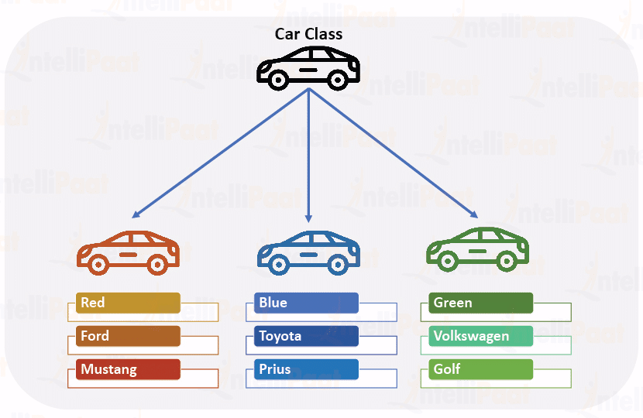
Object Oriented Programming
Class
(https://intellipaat.com, n.d)

Slide 24
Polymorphism
Polymorphism is one of the core concepts of object-oriented programming (OOP) and describes situations in which objects or methods occurs in several different forms.
In computer science, it describes the concept that you can access objects of different types through the same interface.
Each type can provide its own independent implementation of this interface.

Slide 25
Area()
Perimeter()
Area()
Perimeter()
Area()
Perimeter()

Slide 26
Get_salary()
Get_salary()

Slide 27
THANK YOU!

